Slide 1

Session 7 – Python
Brief Intro to Machine Learning with Scikit Learn
Evaluating Accuracy of Classifiers
Doug Bowman

Slide 2
Evaluating Accuracy of Classifiers
Overview
  Precision Recall Curves
    precision_recall_curve()
  Receiver Operating Characteristics (ROC) Curve
    roc_curve()
  Area Under the Curve (AUC)
    roc_auc_score()
  Mean Squared Error
    mse

Slide 3
Evaluating Accuracy of Classifiers
Why accuracy alone isn’t enough
  Skewed datasets
    If the dataset contains many more targets of one classification vs another, it is very easy to get high accuracy by just guessing the most likely class.

Slide 4
Evaluating Accuracy of Classifiers
Why accuracy alone isn’t enough
  High importance of not getting false positives or false negatives
    Predicting a false negative for something like cancer recognition is much less preferred than predicting a false positive.
      i.e. we would rather have the model incorrectly predict a benign tumor is malignant vs predict a malignant tumor benign.

Slide 5
Evaluating Accuracy of Classifiers
Except for mean squared error, all of these methods only apply to classification trainers and models.

Slide 6
Evaluating Accuracy of Classifiers
Abbreviations for Upcoming Slides
  TP = True Positive count
  FP = False Positive count
  TN = True Negative count
  FN = False Negative count

Slide 7
Evaluating Accuracy of Classifiers
Precision
  TP/(TP+FP)
    Represents number of correct classifications of the positive class over all predictions of the positive class
  Can achieve 100% if a single prediction is made and it is correct.
    Must look at other metrics.

Slide 8
Evaluating Accuracy of Classifiers
Recall
  TP/(TP+FN)
    Represents correct predictions of the positive compared to the true number of positive class data points.
  A.k.a. True Positive Rate
  A.k.a. Sensitivity

Slide 9
Evaluating Accuracy of Classifiers
F1 Score
  Harmonic mean of precision and recall.

Slide 10
Evaluating Accuracy of Classifiers
Increasing precision decreases recall, and vice versa.
  Recall = TP/(TP+FN) = TP/All Actual Positives
  Precision = TP/(TP+FP) = TP/All Predicted Positives
  Total number of predictions
    TP + FP + TN + FN

Slide 11
Evaluating Accuracy of Classifiers
Increasing precision decreases recall, and vice versa.
  Which parameter you wish to maximize depends on your application.
  Do you want a balanced classifier? Maximize the F1 score.

Slide 12
Evaluating Accuracy of Classifiers
Increasing precision decreases recall, and vice versa.
  Do we want to minimize false positives? If so, maximize precision.
    We may miss some true positives, but the false positives can be eliminated.
    Think of estimating good tenants. Some tenants who are good will get discarded, but all the tenants chosen will be good tenants.

Slide 13
Evaluating Accuracy of Classifiers
Increasing precision decreases recall, and vice versa.
  Do we want to minimize false negatives? Then maximize recall.
    We can get all the positives, but will also get some false positives in the mix.
    Good for our breast cancer predictions.

Slide 14
Evaluating Accuracy of Classifiers
More Metrics
  False Positive Rate
    FP/(TP+FN) = 1-TNR
  True Negative Rate (Specificity)
    TN/(TN+FP) = 1-FNR
  Accuracy
    (TP + TN)/(TP + TN + FP + FN)

Slide 15
Evaluating Accuracy of Classifiers
Confusion Matrix
  2-dimensional data table
  Measure of how “confused” our model is.
  Each cell shows how many classifications were predicted, and what the actual target was.
  Rows are actual targets
  Columns are predicted targets

Slide 16
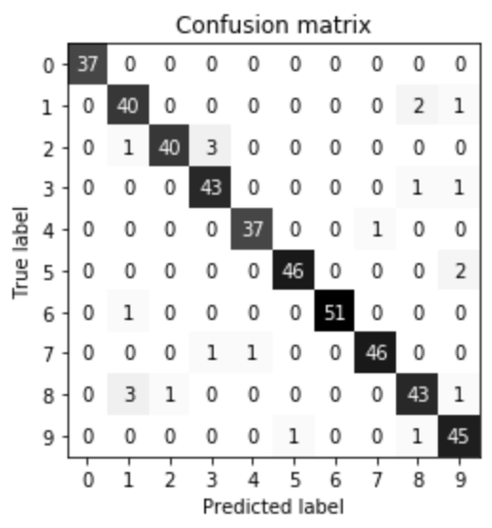
Evaluating Accuracy of Classifiers
Confusion Matrix
  Example

Slide 17
Evaluating Accuracy of Classifiers
Precision Recall Curves
  Plot of precision on the dependent axis, and recall on the independent axis.
  Remember there is a trade-off between precision and recall – we cannot have perfect values for both.

Slide 18
Evaluating Accuracy of Classifiers
Precision Recall Curves
  Plot of precision on the dependent axis, and recall on the independent axis.

Slide 19
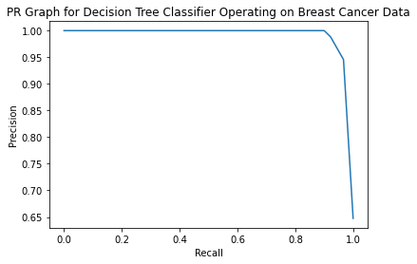
Evaluating Accuracy of Classifiers
Precision Recall Curves

Slide 20
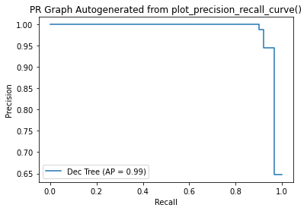
Evaluating Accuracy of Classifiers
Precision Recall Curves

Slide 21
Evaluating Accuracy of Classifiers
Receiver Operating Characteristics (ROC) Curve
  Plots True Positive Rate vs False Positive Rate.
  Points further to the upper left corner are more accurate at making predictions.

Slide 22
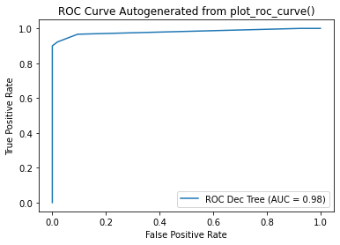
Evaluating Accuracy of Classifiers
Receiver Operating Characteristics (ROC) Curve

Slide 23
Evaluating Accuracy of Classifiers
Area Under the Curve (AUC)
  This is the area under the ROC curve.
  Gives a single value measure of the ROC performance of a classifier.
  Values of 1 represent a perfect classifier.
  Values of 0.5 represent a purely random classifier.

Slide 24
Evaluating Accuracy of Classifiers
Multiclass Classifier Evaluation
  Most methods up to this point have been for binary classification applications.
  Can compare each class prediction vs another in each classifier to estimate performance.

Slide 25
Evaluating Accuracy of Classifiers
Multiclass Classifier Evaluation
  For instance, can create multiple models predicting whether each data point is a true or false for each classification.
    First model predicts whether the iris is a virginica
    Second model predicts whether the iris is a versicolor
    Etc.

Slide 26
Evaluating Accuracy of Classifiers
Summary
  Each of these metrics is a measure of prediction abilities for a given classifier.
  A higher score from one metric does not always mean the classifier is better. Each application has unique needs, and trade-offs need to be evaluated.

Slide 27
Evaluating Accuracy of Classifiers
Go over in-class examples

Slide 28

Evaluating Accuracy of Classifiers
In-Class Exercise
  With the data of your choice, build a classifier and show the following:
    Display the PR curve
    Display the ROC curve
    Calculate the AUC for the ROC curve
    Generate a confusion matrix.
  With data of your choice, build two classifiers and pick the better classifier based on performance metrics. What metrics are important to the data set you have chosen?

Slide 29

Bibliography
https://github.com/amueller/introduction_to_ml_with_python/blob/master/02-supervised-learning.ipynb
Müller, A. C., & Guido, S. (2016). Introduction to Machine Learning with Python: A Guide for Data Scientists (1st ed.). O’Reilly Media.
http://rasbt.github.io/mlxtend/user_guide/general_concepts/gradient-optimization/

Slide 30
Bibliography
https://github.com/ageron/handson-ml
Géron Aurélien. Hands-on Machine Learning with Scikit-Learn and Tensorflow. 1st ed., O'Reilly, 2017.
https://machinelearningmastery.com/how-to-use-correlation-to-understand-the-relationship-between-variables/

Slide 31
Bibliography
Harrison, Matt. Machine Learning Pocket Reference: Working with Structured Data in Python. 1st ed., O'Reilly, 2019.
https://scikit-learn.org/stable/modules/cross_validation.html
Scikit-learn: Machine Learning in Python, Pedregosa et al., JMLR 12, pp. 2825-2830, 2011.

Slide 32
Bibliography
API design for machine learning software: experiences from the scikit-learn project, Buitinck et al., 2013.
https://docs.scipy.org/doc/scipy/reference/generated/scipy.stats.pearsonr.html
https://docs.scipy.org/doc/scipy/reference/generated/scipy.stats.spearmanr.html#scipy.stats.spearmanr

Slide 33
Bibliography
https://www.investopedia.com/terms/p/p-value.asp
https://scikit-learn.org/stable/auto_examples/manifold/plot_swissroll.html#sphx-glr-auto-examples-manifold-plot-swissroll-py
https://scikit-learn.org/stable/auto_examples/manifold/plot_compare_methods.html#sphx-glr-auto-examples-manifold-plot-compare-methods-py

Slide 34
Bibliography
16) https://wizardforcel.gitbooks.io/scikit-and-tensorflow-workbooks-bjpcjp/content/ch08-dimensionality-reduction.html
17) https://pub.towardsai.net/principal-component-analysis-in-dimensionality-reduction-with-python-1a613006d531
18) https://towardsdatascience.com/the-kernel-trick-c98cdbcaeb3f

Slide 35
Bibliography
19) https://cs.nyu.edu/~roweis/lle/papers/lleintro.pdf
20)https://docs.python.org/3/library/json.html
21)https://academic.oup.com/bioinformatics/article/24/18/2010/190849?login=false
22)https://arxiv.org/pdf/1904.10416.pdf
23)

Slide 36
Additional Resources
https://towardsdatascience.com/over-fitting-and-regularization-64d16100f45c
https://towardsdatascience.com/scale-standardize-or-normalize-with-scikit-learn-6ccc7d176a02

Slide 37
LICENSE
Copyright 2022 Douglas Bowman
Permission is hereby granted, free of charge, to any person obtaining a copy of this software and associated documentation files (the "Software"), to deal in the Software without restriction, including without limitation the rights to use, copy, modify, merge, publish, distribute, sublicense, and/or sell copies of the Software, and to permit persons to whom the Software is furnished to do so, subject to the following conditions:
The above copyright notice and this permission notice shall be included in all copies or substantial portions of the Software.
THE SOFTWARE IS PROVIDED "AS IS", WITHOUT WARRANTY OF ANY KIND, EXPRESS OR IMPLIED, INCLUDING BUT NOT LIMITED TO THE WARRANTIES OF MERCHANTABILITY, FITNESS FOR A PARTICULAR PURPOSE AND NONINFRINGEMENT. IN NO EVENT SHALL THE AUTHORS OR COPYRIGHT HOLDERS BE LIABLE FOR ANY CLAIM, DAMAGES OR OTHER LIABILITY, WHETHER IN AN ACTION OF CONTRACT, TORT OR OTHERWISE, ARISING FROM, OUT OF OR IN CONNECTION WITH THE SOFTWARE OR THE USE OR OTHER DEALINGS IN THE SOFTWARE.

